Slide 1

Analysing Bias in 2024 UK Election News Articles
A Comprehensive Data Scraping and Sentiment Analysis Approach

Slide 2
Project Overview
Objective: To detect and visualise potential bias in news articles related to the 2024 UK election.
Methods: Data scraping, cleaning, sentiment analysis, and visualisation.
Outcome: Development of a comprehensive dataset for bias analysis using Tableau.
Notes:
Provide a high-level overview of the project’s goals and the approach taken.

Slide 3
Data Collection Process
Libraries Used: BeautifulSoup, requests, pandas, NumPy.
Functionality: Scraping news links and article content from various sources.
Output: CSV file with raw news articles data.
Notes:
Explain the data scraping process, mentioning the libraries used and the purpose of scraping.

Slide 4
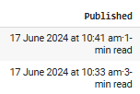

Data Cleaning and Preparation
Text Cleaning: Removal of URLs, email addresses, emojis.
Tokenisation: Splitting text into words, removing stop words and punctuation.
Formatting: Conversion of dates to a standard format.
Going from this:
To this:
Notes:
Explain the data scraping process, mentioning the libraries used and the purpose of scraping.

Slide 5
Data Integration and Relational Tables
Concatenation: Merging CSV files into a single data frame.
Deduplication: Removing duplicate entries.
Relational Tables: Creation of tables for articles, authors, dates, and sources.
Notes:
Explain the process of integrating various data sources and the creation of relational tables for better data management.

Slide 6
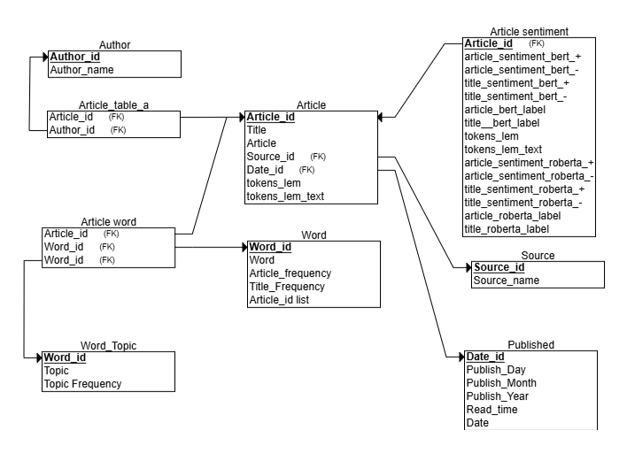
Data Integration and Relational Tables
Notes:
Talk about the creation is for efficiency and creating ids
The certain table for relating other tables like article –word, article – author
Sentiment, word, topic table created after machine learning stage

Slide 7

Sentiment Analysis Process
Libraries Used: NLTK, TextBlob, transformers (BERT, RoBERTa).
Sentiment Techniques: Rule-based (VADER), machine learning-based.
Labelling: Assigning
neutral,
positive,
or negative labels to articles.
BERT
RoBERTa
Notes:
Describe the sentiment analysis methods used and how sentiments were labelled in the articles.

Slide 8
Topic Handling Process
Topic Modelling: Utilised Latent Dirichlet Allocation (LDA) to identify topics in articles.
Topic Classification:
Step: Classified articles based on the predominant topic they discussed.
Tools: Used Python libraries such as Gensim and Scikit-learn for topic analysis.
Topic Frequency Analysis: Analysed the frequency of each topic across different articles.
Notes:
Talk about The Topics and the labels will be seen in Tableau

Slide 9
Quality Control and Data Validation
Random Checks: Ensuring data quality through random sampling.
Consistency Checks: Verifying consistent application of sentiment labels.
Notes:
Emphasise the importance of quality control in maintaining the accuracy and reliability of your analysis. As it Is unsupervised, check that the values make sense

Slide 10
Data Export and Preparation for Visualization
File Formats: Saving data in CSV for Tableau.
Relational Integrity: Maintaining links between tables for comprehensive analysis.
Let’s go to Tableau !!!

Slide 11
Next Steps and Future Work
Data Analysis: Perform in-depth analysis in Tableau.
Further Refinement: Continuously refine data processing and sentiment analysis methods.
Broader Application: Explore potential applications to other datasets or elections.
Notes:
Outline the next steps for the project and potential areas for future work or improvement.

Slide 12
Questions & Answers

Slide 13
Thank You For Listening !

